Slide 1

DEPARTMENT OF COMPUTER SCIENCE AND ENGINEERING
Professional Training I
IT Helpdesk & Ticket Resolution Dashboard
PROJECT STUDENT
Syed Ibrahim.A
44111022
GUIDE
Mr Mohammed Haseeb Rakshan P

Slide 2
AGENDA
Abstract
Introduction
Objective
System Architecture / Ideation Map
Module Implementation
Results and Discussions
Conclusion
References

Slide 3
ABSTRACT
This project delivers an interactive IT Helpdesk & Ticket Resolution Dashboard created in Microsoft Power BI to transform raw support ticket data into actionable operational insights. By centralizing key performance metrics, the dashboard offers a comprehensive view of total ticket volumes, categorizations, priority distributions, and resolution statuses across the organization. It evaluates technician workloads, resolution speeds, and Service Level Agreement (SLA) compliance rates to pinpoint operational bottlenecks, delays, and capacity imbalances. Designed for strategic decision-making, this business intelligence solution equips management with clear visual reports to streamline support workflows, optimize resource allocation, and enhance overall IT service efficiency.

Slide 4
INTRODUCTION
Manual analysis makes performance monitoring difficult.
Power BI provides interactive and centralized visualization.
It centralizes helpdesk data for easy analysis.
It provides quick insights into ticket trends and performance.
It helps identify delays and areas requiring improvement.
It enables data-driven monitoring of IT support operations.

Slide 5
OBJECTIVE
Monitor ticket status and priority.
Measure resolution time and SLA compliance.
Analyze technician workload.
Identify common issue categories.
Track ticket trends over time.
Identify delays and unresolved tickets.
Support data-driven decision-making.

Slide 6
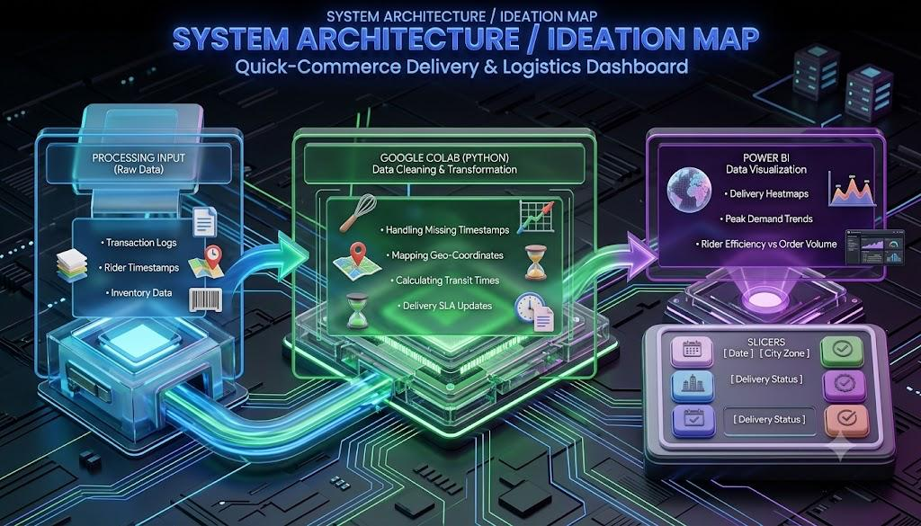
SYSTEM ARCHITECTURE

Slide 7
MODULE IMPLEMENTATION
Data Collection: Import and organize IT helpdesk ticket data from structured sources.
Data Preprocessing: Clean, validate, and standardize the dataset by handling missing and duplicate records.
Data Transformation: Prepare relevant fields and create calculated columns for analysis.
Data Modeling: Establish relationships between data tables for efficient analysis.
KPI Development: Create key performance indicators using DAX.
Dashboard Development: Design interactive Power BI dashboards with relevant charts, cards, and filters.
Performance Monitoring: Analyze ticket status, resolution time, technician workload, and SLA compliance.
Insight Generation: Identify ticket trends, service delays, and areas for operational improvement.

Slide 8
Results and Discussions
Identifies major issue categories and priorities.
Monitors technician workload and resolution time.
Highlights SLA performance and support trends.
Identifies unresolved and high-priority tickets.
Enables comparison of ticket volumes across categories.
Supports data-driven improvements in helpdesk operations.

Slide 9
CONCLUSION
Provides centralized and interactive monitoring through Power BI.
Enables effective analysis of ticket and support performance.
Improves visibility into resolution time and SLA compliance.
Supports efficient resource and workload management.
Establishes a foundation for future predictive analytics.
Facilitates data-driven operational decision-making.

Slide 10
REFERENCES
Microsoft Power BI Documentation
Microsoft Power Query Documentation
Microsoft DAX Documentation
DAX Function Reference
Power BI Guidance & Best Practices
Microsoft Learn – Power BI Data Analyst Resources
IT Service Management (ITSM) – Service Desk & SLA Concepts
Dataset used for IT Helpdesk Ticket Analysis

Slide 11
THANK YOU
We thank God, Our Department, Guide, Panel Members, Supportive Professors and all Technical and non Technical staff who helped us in our Project.

